Slide 1
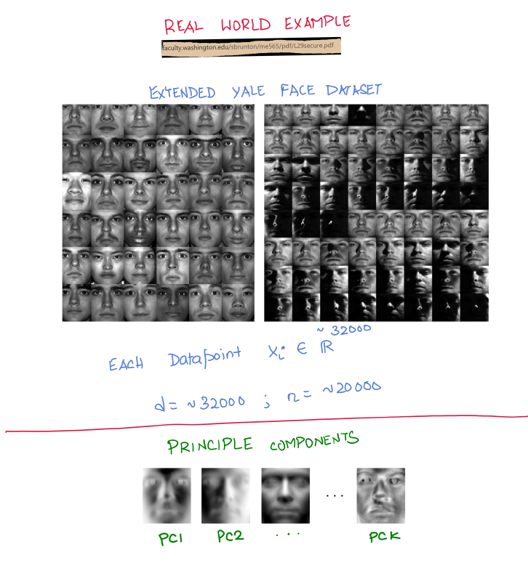
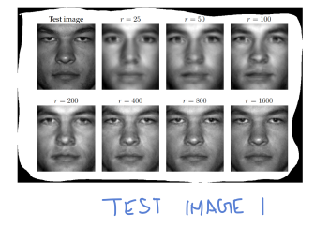
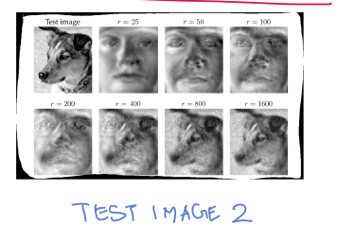

Slide 2
Summary of PCA
-> Given a dataset, we wanted to find a compressed representation.
-> In other words, we wanted to find a subspace that best “represents” the data
-> Best representation => Error is minimum ⬄ variance is maximum
-> The principal directions can be chosen greedily ! (In practice using SVD)
-> Extremely useful for real world data such as images.

Slide 3


















Slide 4





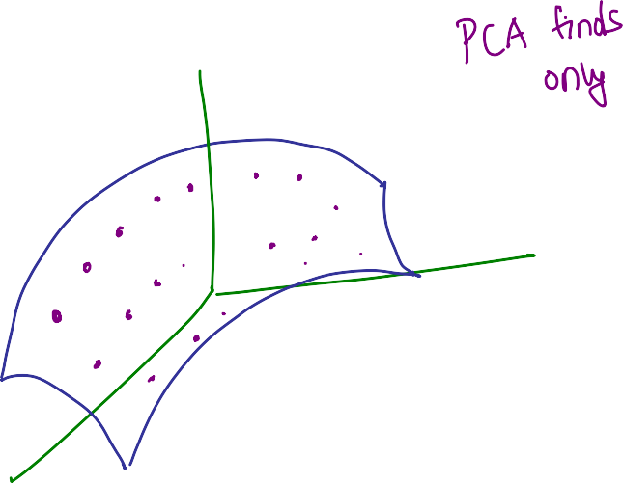












Slide 5















Slide 6












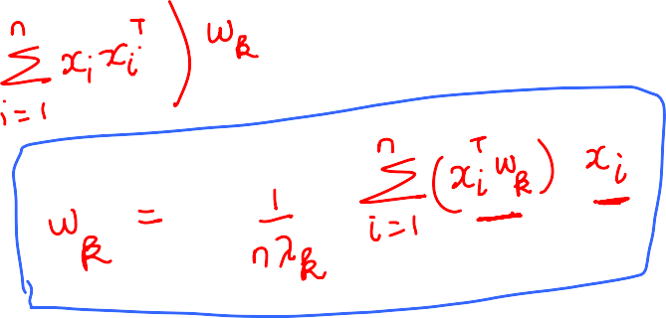


Slide 7










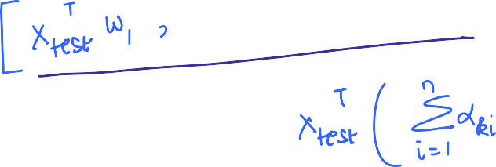


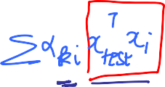


Can obtain compressed representation only by knowing alphas

Slide 8























Slide 9





















Slide 10


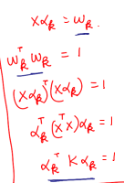
Observation:

Slide 11




















Summary so far

Slide 12
























**
** - The non-zero Eigenvalues of XX^{T} and X^{T}X are the same – proved using SVD of X

Slide 13


























Slide 15












Key advantages of this method

Slide 16

















Slide 17

















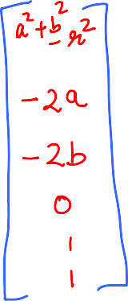











Slide 18


























Slide 19
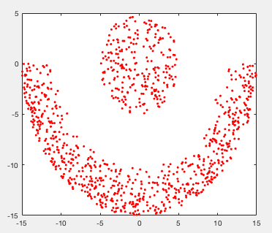
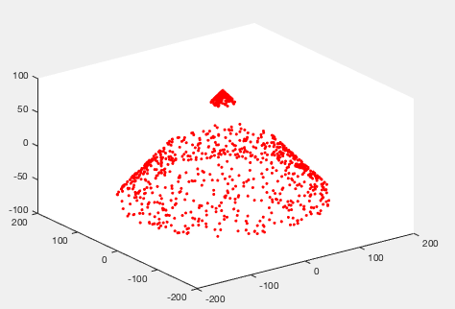
ORIGINAL DATA
3D REPRESENTATION
Quadratic Map ϕ
to 6 Dimensions
PCA
w1,w2,w3
Top 3 principal
components
Reconstruct
each point x as
[ϕ(x)’w1 ϕ(x)’w2 ϕ(x)’w3]

Slide 20






















Slide 21





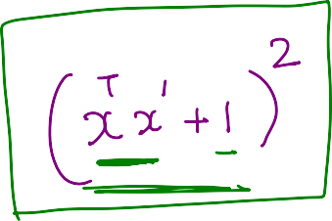






Slide 22
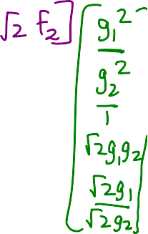





x
ϕ(x)
Hard
ϕ(x)’ ϕ(x’)
x’
ϕ(x’)

Slide 23
Summary/Questions
-> To capture non-linear relationships, one can “create” non-linear functions of
features.
-> But the number of features to create grows exponentially with the degree
of non-linearity p that we wish to capture (d^{p})
-> For d = 2 and p = 2, it appears there is a trick to get around this.
-> Is this trick general enough to be useful the general case as well?
(i.e., for any d and any p?)

Slide 24




























Slide 25





































Slide 26





























Slide 27






















Slide 28



























Slide 29



















Slide 30















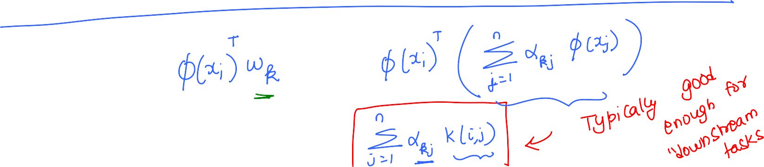

Slide 31
What about Centering?
Even if center the original data, it does not guarantee that the data will be
centered after applying the transformation ϕ
We want to work with the centered data w.r.t to {ϕ(x₁), ϕ(x₂), … , ϕ(x_{n})}
Let μ = 1/n Σϕ(x_{ℓ})
The (i,j) term in the pairwise dot product matrix in the high dimension will
(ϕ(x_{i}) – μ)^{T}(ϕ(x_{j}) – μ) = ϕ(x_{i}) ^{T}ϕ(x_{j}) - ϕ(x_{i})^{T}μ - ϕ(x_{i})^{T}μ + μ^{T}μ
= ϕ(x_{i}) ^{T}ϕ(x_{j}) - ϕ(x_{i})^{T} (1/n Σϕ(x_{ℓ}))- ϕ(x_{i})^{T} (1/n Σϕ(x_{ℓ}) )
+ (1/n Σϕ(x_{ℓ}))^{T} (1/n Σϕ(x_{ℓ}))
= K(i,j) – 1/nΣK(i, ℓ) – 1/nΣK(j, ℓ) – 1/n²ΣΣK(ℓ, ℓ’)
Good news - Each term depends only on K

Slide 32
Step 1.5 Center Kernel using ①

Slide 33
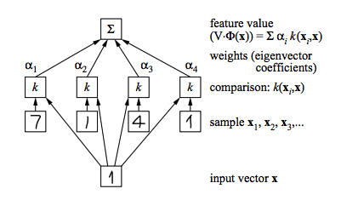
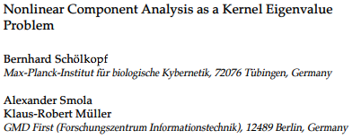

Slide 34

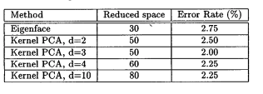

Application of Kernel-PCA to face recognition
400 images of 40 subjects with different expression/poses.
Each image is (23*28) = 644 dimensional
Apply Kernel PCA to obtain features
Use features as input to a simple supervised learning algorithm
(which we will see later)
Results:

